Slide 1

Payroll Forms
International students: e-mail the payroll office payroll@uakron.edu
Paper Forms
Non-Resident Alien Identification Form
Form SSA-1945
Online
Direct Deposit Form
2023 W-4 Form
Ohio IT-4 Form

Slide 2
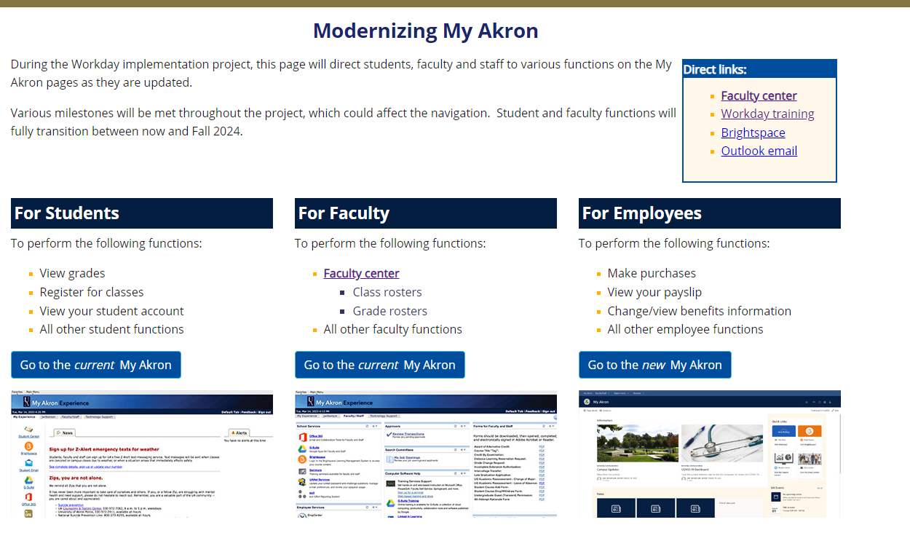
ONLINE ONBOARDING
TAX FORMS
Select Go to new My Akron

Slide 3
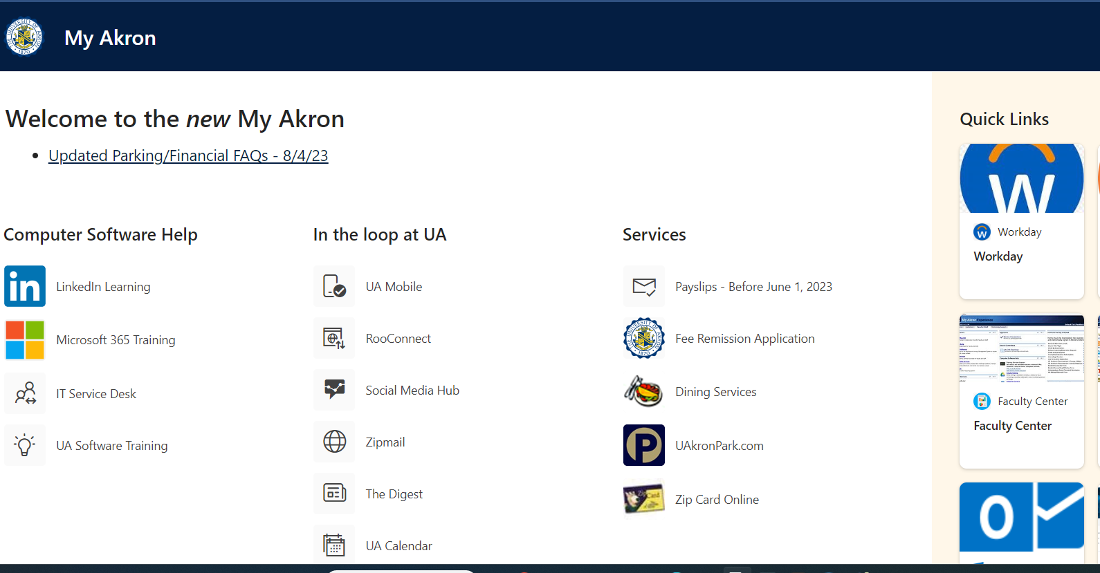
TAX FORMS CONTINUTED
Select the Workday Icon

Slide 4
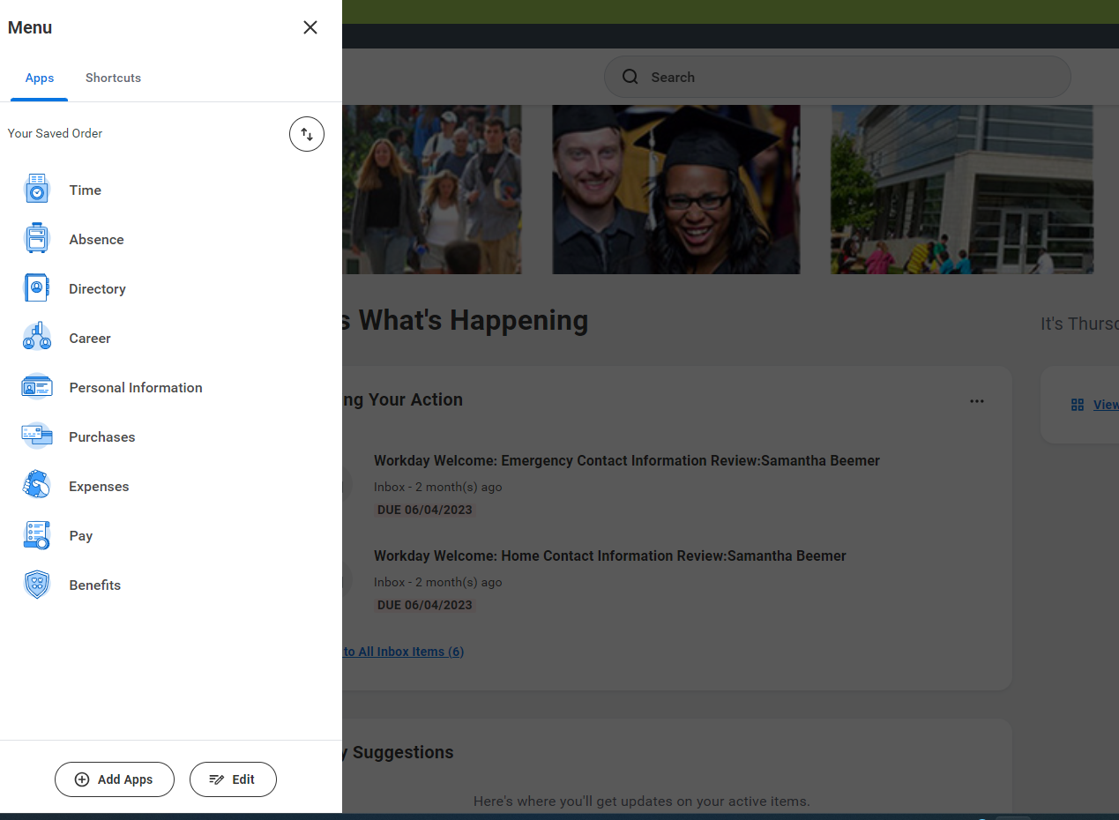
TAX FORMS CONTINUTED
Hit the Menu at the top Left and in the drop down Select Pay

Slide 5
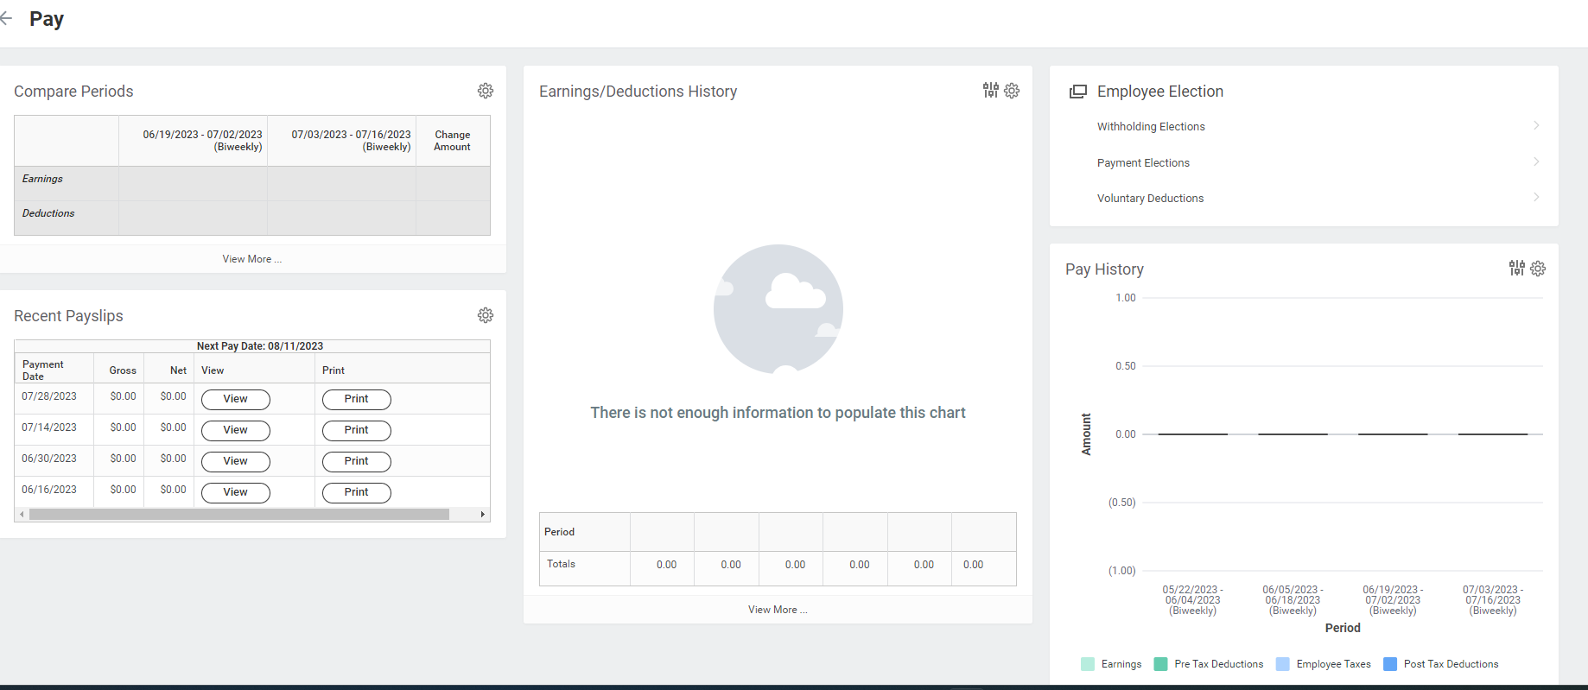
TAX FORMS CONTINUTED
Select Withholding Election

Slide 6
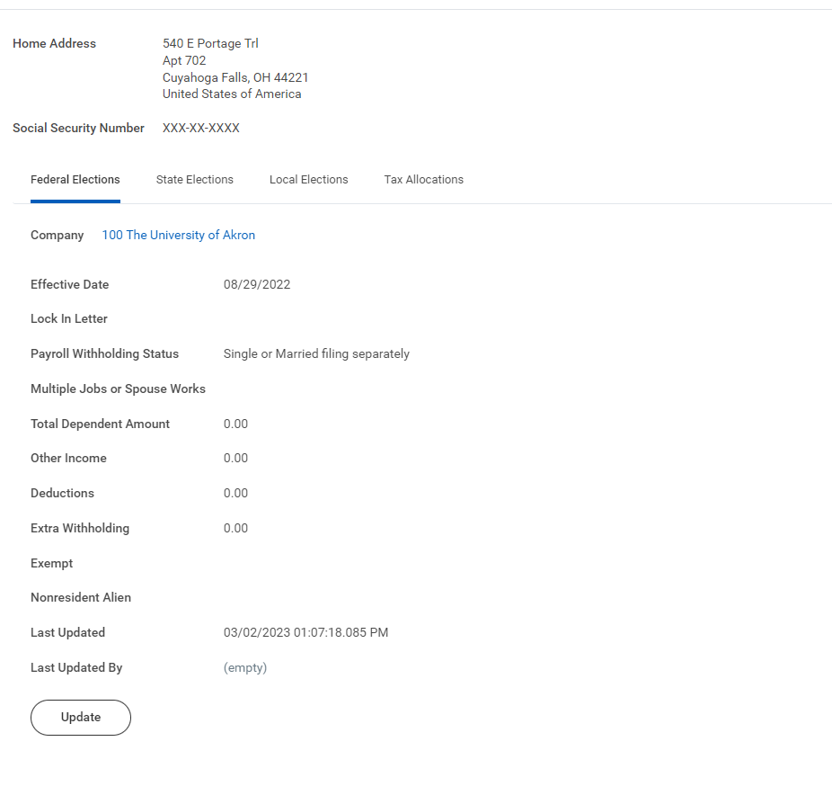
TAX FORMS CONTINUTED
Under each heading click the Update icon and compete the tax election

Slide 7
Direct Deposit
Go back to the pay page and Select Payment Elections

Slide 8
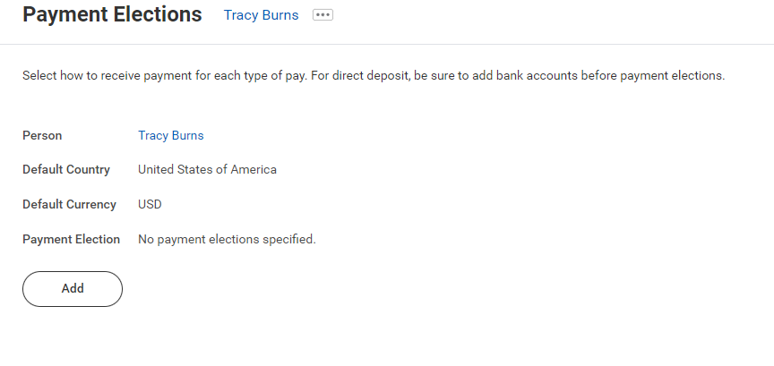
Direct Deposit Continued
Select Add

Slide 9
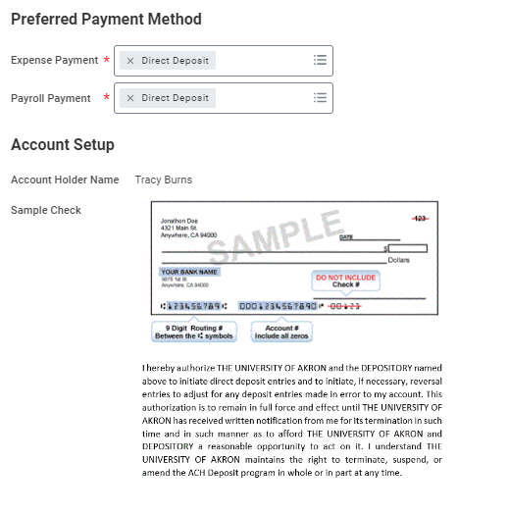
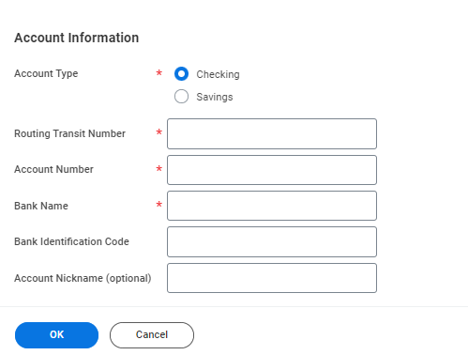
Direct Deposit Continued
Fill in the red Asterisk – Routing number, Account number and Bank name
Click OK

Slide 10
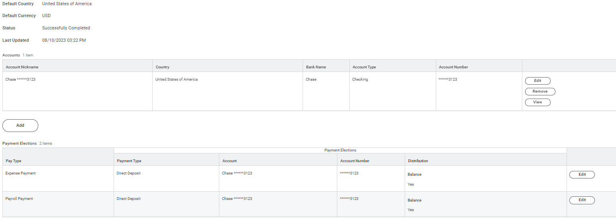
Direct Deposit Continued
This is your bank account set up. If you need to correct the information. You select edit in the second box and submit the changes.

Slide 11
State Retirement
OPERS Exemption Form or Election Form for Students
  (Hired on or after September 28, 2016)
SERS Exemption Form or Membership Record
Students are eligible to be exempt from state retirement membership while regularly attending classes. Before you sign a student exemption, consider that the service credit you earn while in college counts toward your retirement if you become employed in the public sector during your career.
30 days from date of hire to submit an exemption form
(August 22 start must submit by September 20)
Forms available on the Payroll Forms web page: https://www.uakron.edu/controller/payroll-forms.dot

Slide 12
Graduate Teaching Assistants
If you are an active member in State Teachers Retirement System of Ohio (STRS) and you are not on a leave of absence from a teaching position covered by STRS Ohio, you may apply for exemption from contributions to STRS Ohio.
Please consult the STRS Ohio website at https://www.strsoh.org/employer/reporting/determination/exemptions.html
for more information and an “Exemption from Contributions for Student Employees” application form.
If you are an active member in State Teachers Retirement System of Ohio (STRS) and on a leave of absence from a teaching position covered by STRS Ohio, or wish to contribute to STRS Ohio, you must complete a “Member Information” form.
The form is available on the STRS Ohio website at https://www.strsoh.org/employer/reporting/new-hire/overview.html.

Slide 13
Biweekly payroll schedule
https://www.uakron.edu/controller/payroll.dot
Submit all Payroll forms to the Payroll Office:
Administrative Services Building (ASB) Room 102
185 East Mill Street, Akron, Ohio 44325
Questions?
Contact | Last Name Begins With | Ext
Sue Allshouse | A – G | 6759
Carla Corsaro | H – O | 6555
Ruth Roberts | P - Z | 6558
Brenda McHenry | International Students | 2312

